Slide 1
Fine-Tuning Phi-2 for Dialogue Summarization

Slide 2
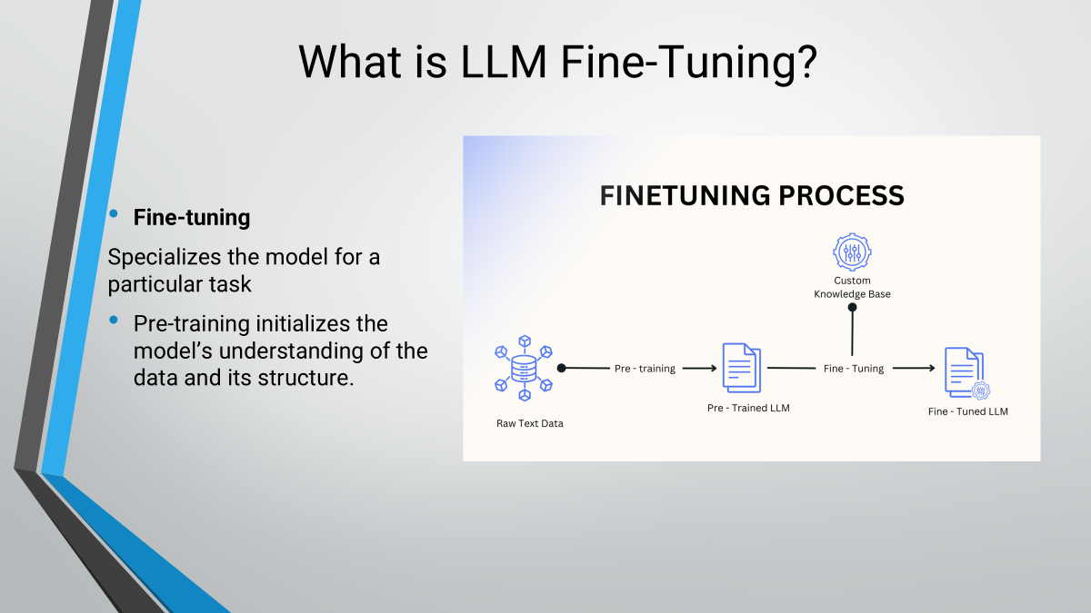
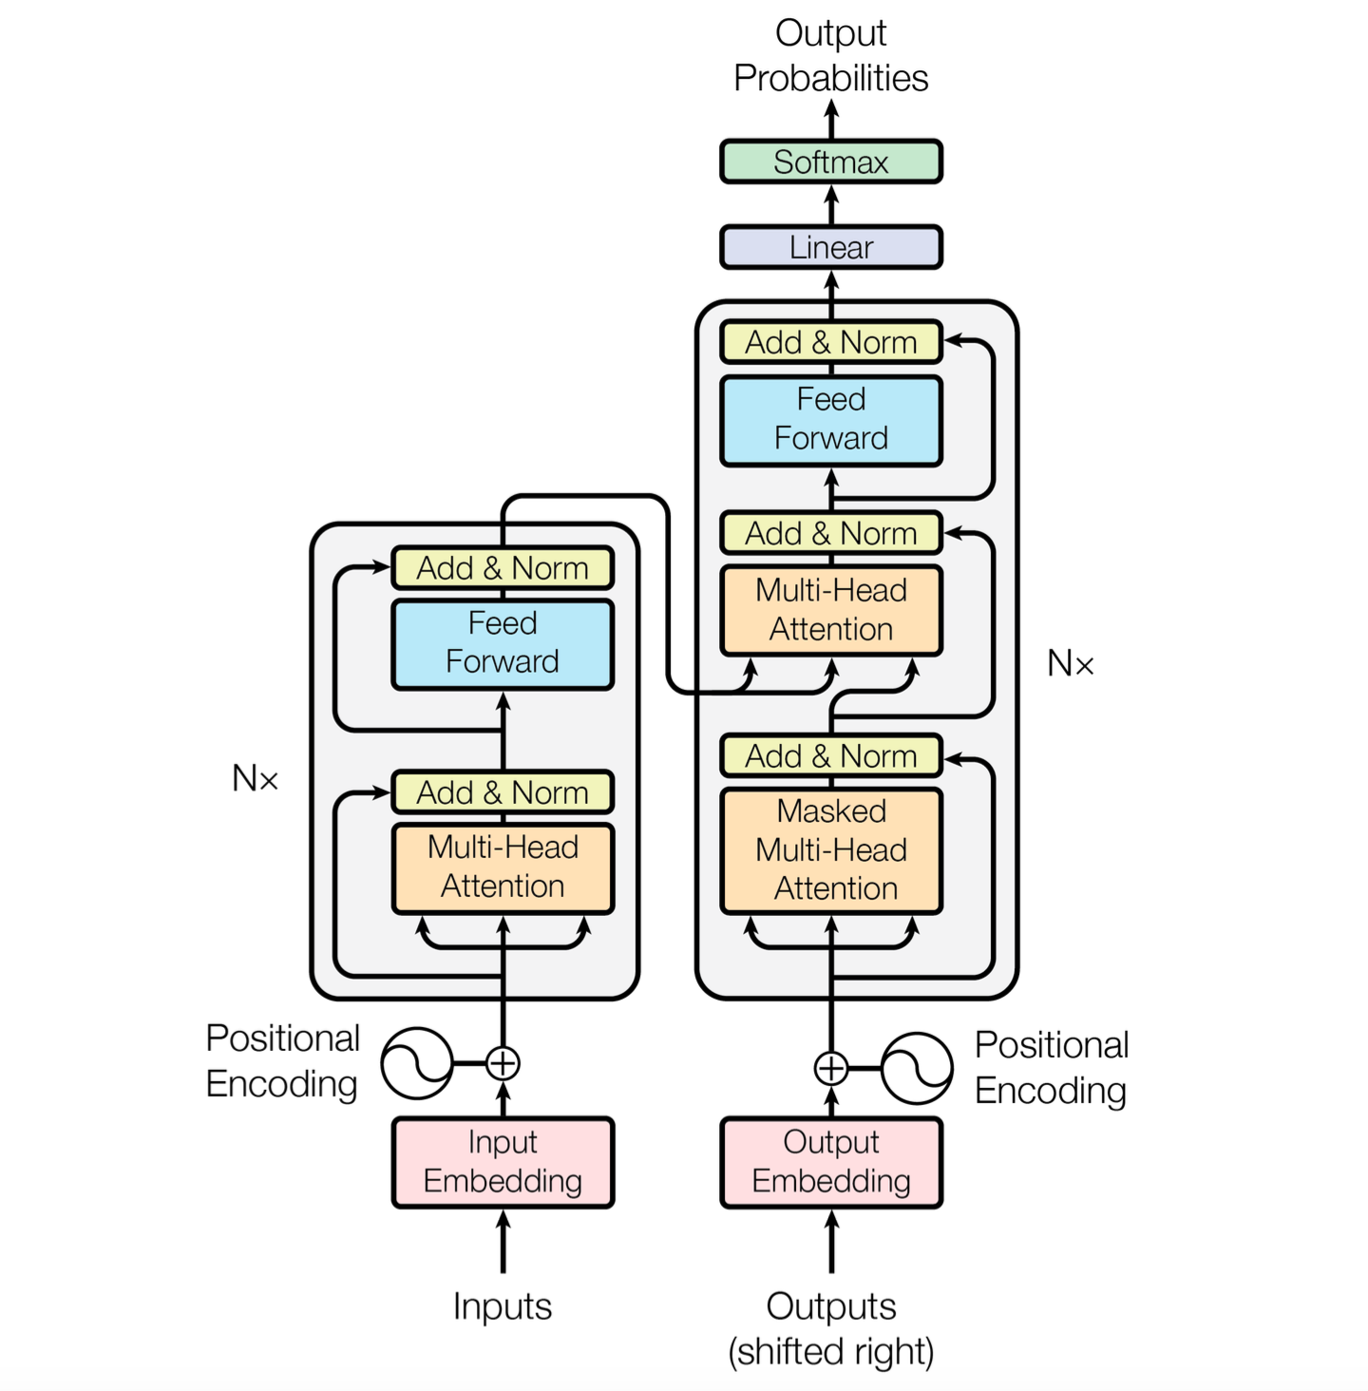
The Model and Algorithms
Base Model: Phi-2, known for its robust performance in NLP tasks.
Training Techniques:
Loss optimization using sequence-to-sequence methods.
Adaptation for multi-turn dialogue summarization using fine-tuned weights.

Slide 3
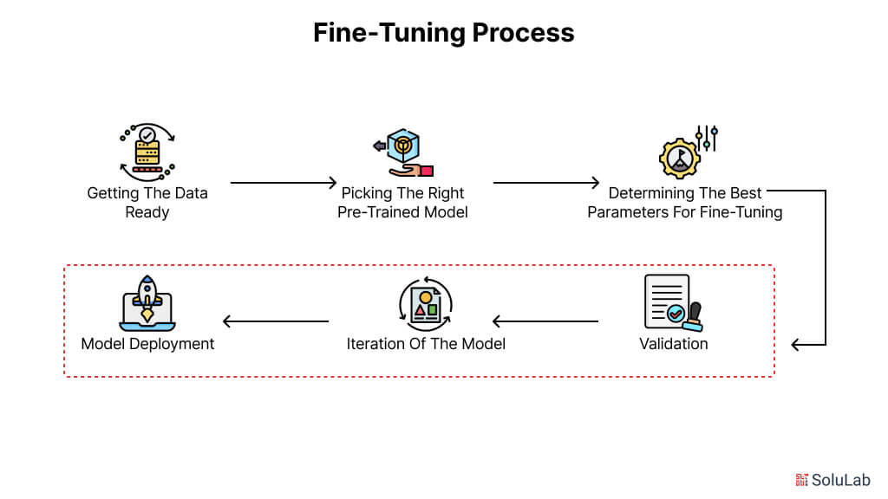

Key Steps in Fine-Tuning
Choose a Pre-Trained Model: Phi-2 was selected for its efficiency and performance in natural language tasks.
Gather Relevant Datasets: Used DialogSum and DialogSum-test from Hugging Face
Preprocess the Data: Cleaned and split data into training, validation, and test sets.
Fine-Tune the Model: Adjusted weights to adapt Phi-2 for dialogue summarization.

Slide 4
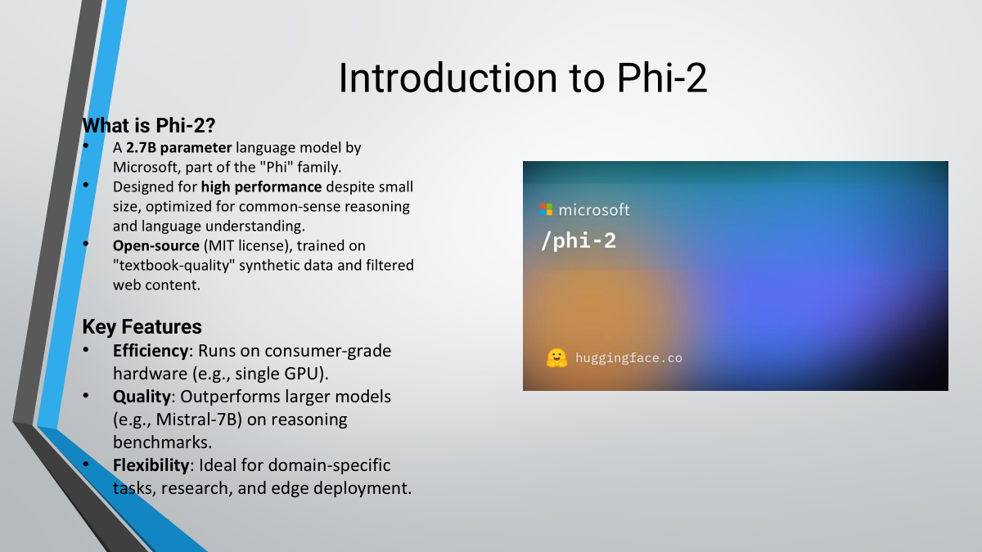
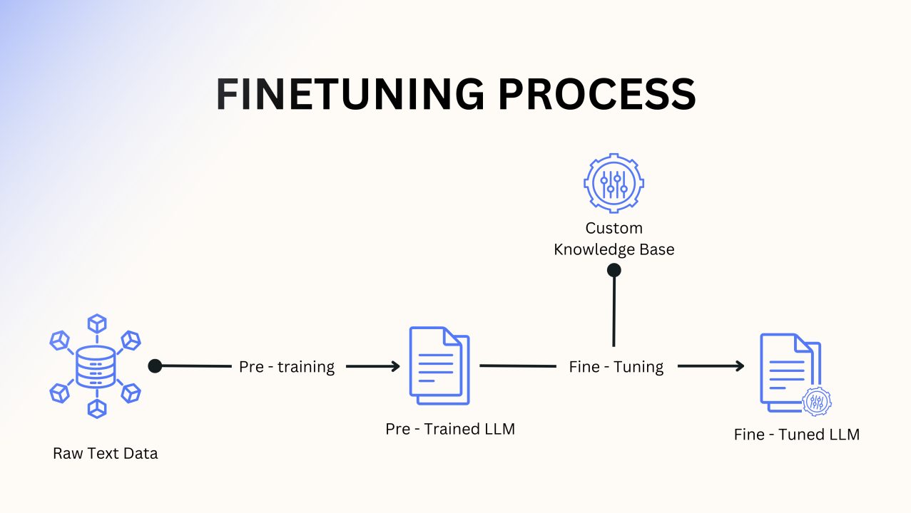
What is LLM Fine-Tuning?
Fine-tuning
Specializes the model for a particular task
Pre-training initializes the model’s understanding of the data and its structure.

Slide 5
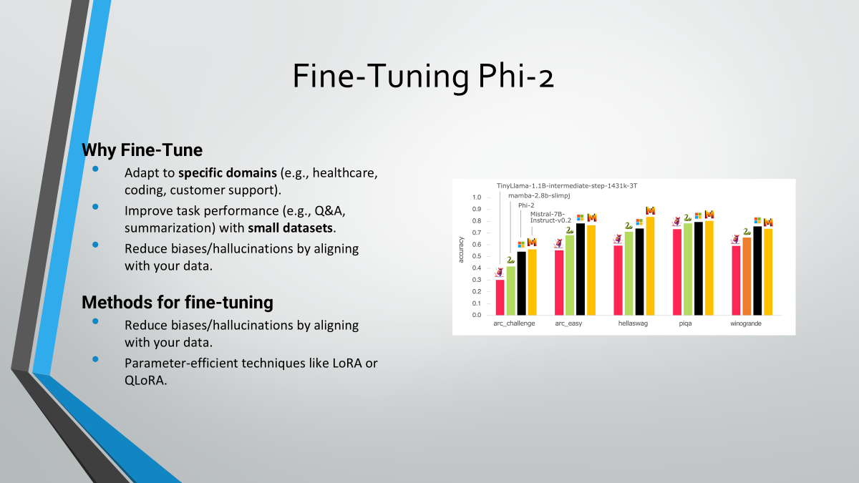
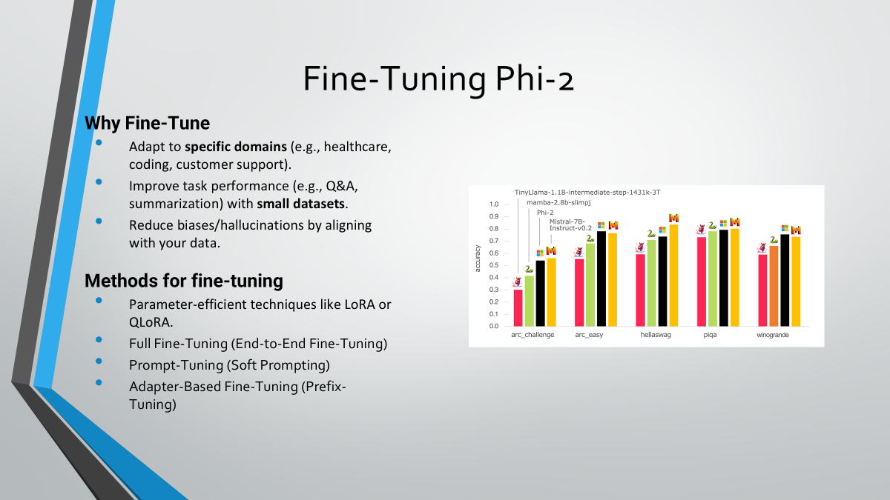
Fine-Tuning Methods
Large language models (LLMs) like GPT and BERT are incredibly powerful but have millions or even billions of parameters. Full fine-tuning these models for every specific task:
Consumes enormous computational resources.
Requires storage for multiple large models.
Is inefficient for tasks where the data or model changes frequently.
Parameter-Efficient Fine-Tuning (PEFT): Updates only a subset of the parameters, freezing the rest. Efficient, maintains original weights, and reduces computational costs.

Slide 6
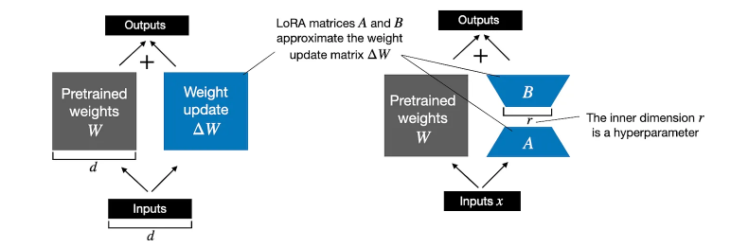
PEFT with Low-Rank Adaptation
LoRA offers low-rank updates to efficiently fine-tune models while freezing the pretrained weights.
It reduces storage and computational costs without sacrificing much performan

Slide 7
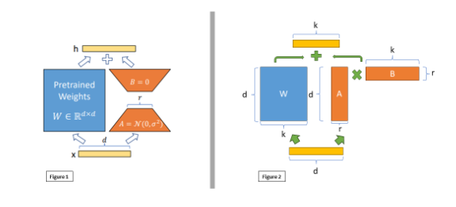
How does LORA work?
Instead of updating the entire weight matrix WWW during fine-tuning, LoRA introduces a low-rank decomposition of the weight updates.

Slide 8
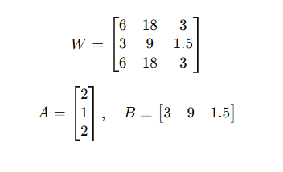
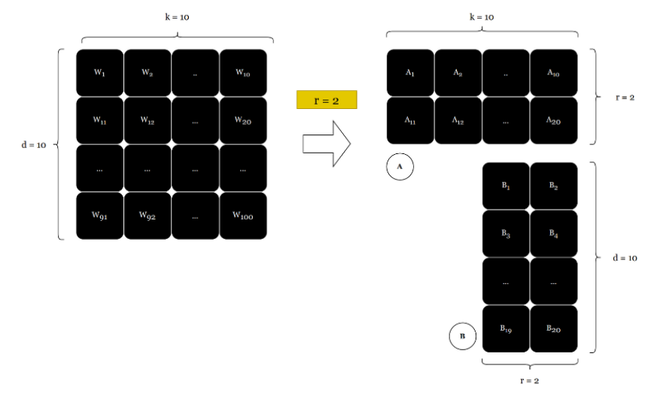
Matrix Decomposition

Slide 9
Hyperparameters in LoRA
Rank (r):
Determines the dimensionality of the low-rank update.
Typical values: 2,4,8,16,32,64,128,512
Learning Rate (α):
Lower learning rates stabilize fine-tuning.
Dropout:
LoRA can add dropout to ΔW\Delta WΔW for regularization.
Layer-wise Fine-Tuning:
Fine-tune only certain layers or components .

Slide 10
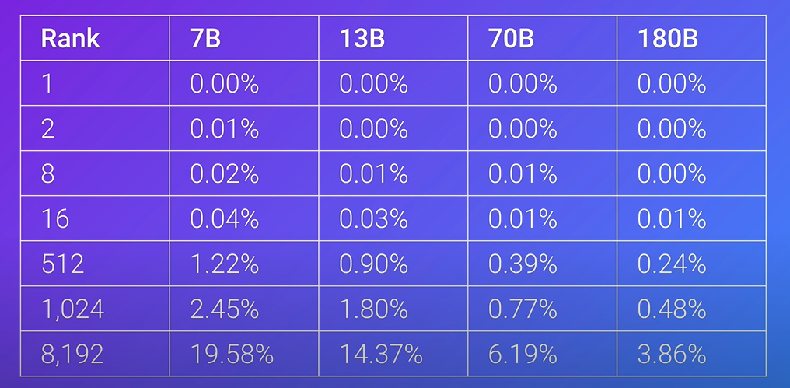
Effect of the Hyperparameters

Slide 11
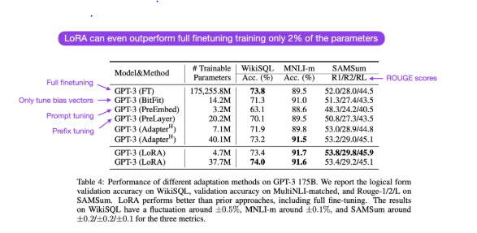
Effect of the Hyperparameters

Slide 12
Effect of the Hyperparameters
We need to fine-tune all layers to achieve a result similar to full fine-tuning.
If full fine-tuning is not feasible, we usually train only the attention layers (query, key, and value).
Studies have shown that the rank does not affect the result when fine-tuning all layers

Slide 13
Quantized LORA
As models grow larger, fine-tuning them becomes increasingly expensive in terms of memory and computation. While LoRA reduces the number of trainable parameters, it still requires storing the full model in memory.
QLoRA (Quantized LoRA) solves this problem by compressing the base model into 4-bit precision, allowing fine-tuning of massive models on consumer GPUs—all while maintaining performance close to full fine-tuning.

Slide 14
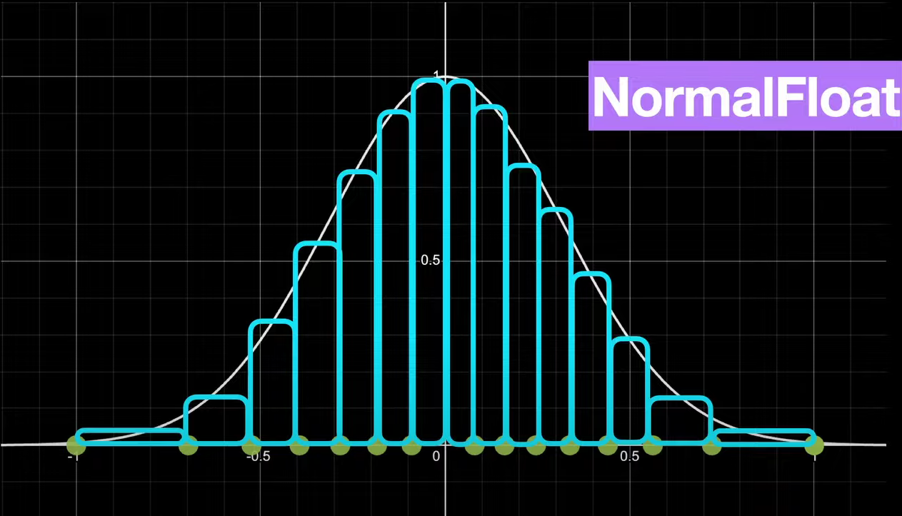
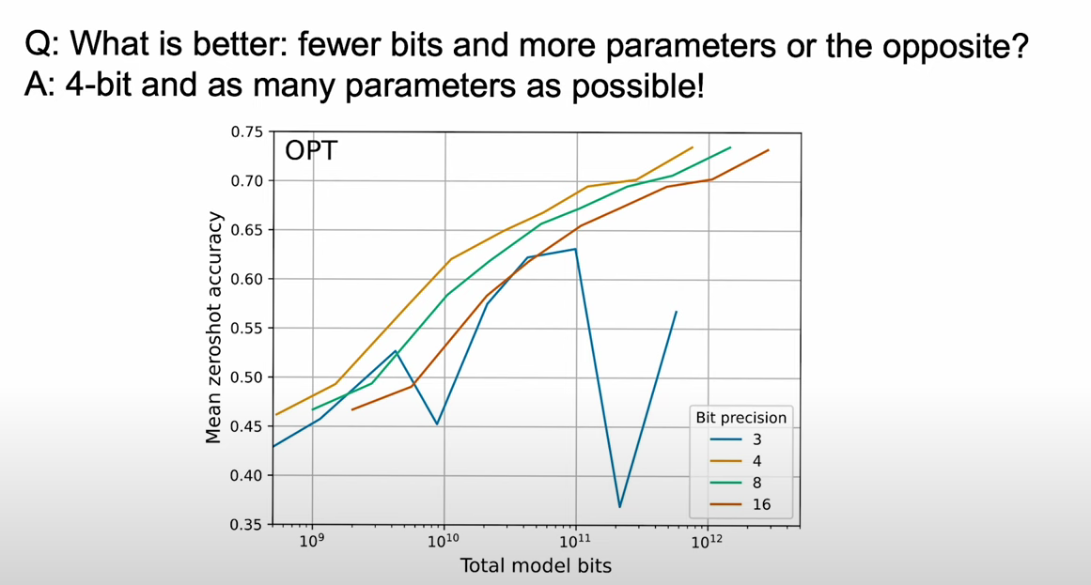
How does QLORA work?

Slide 15
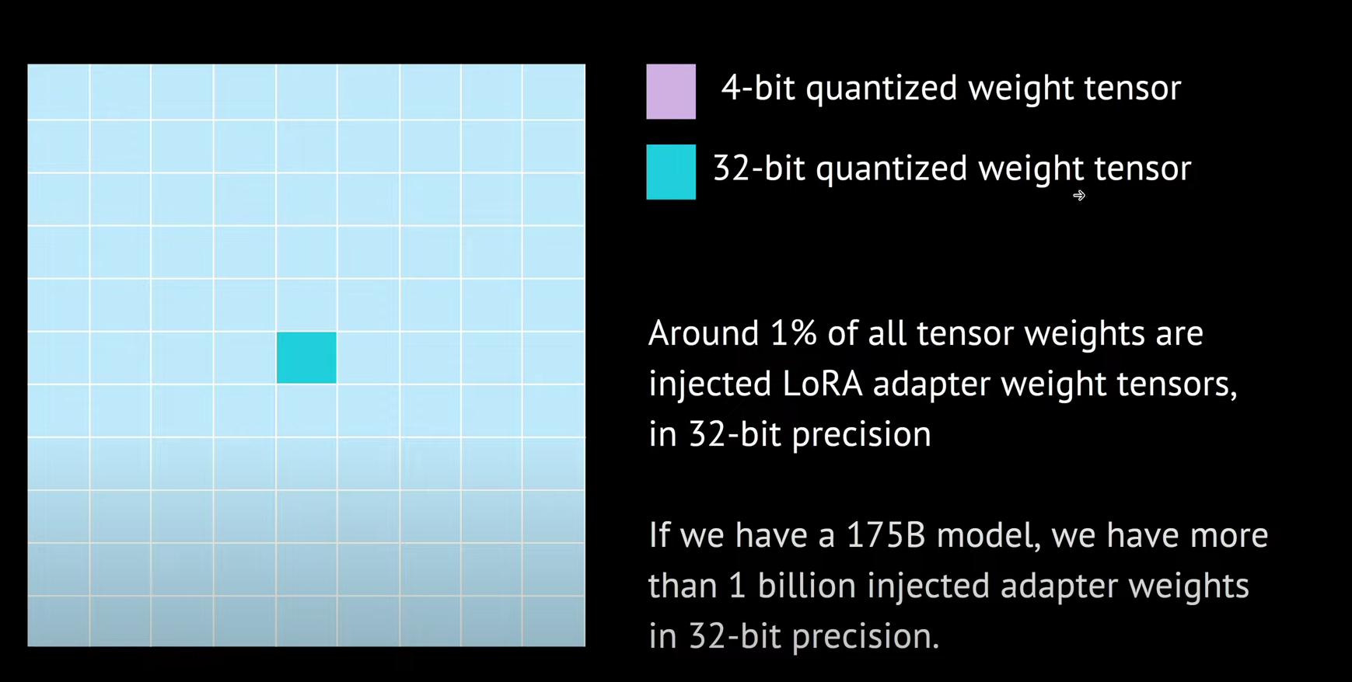
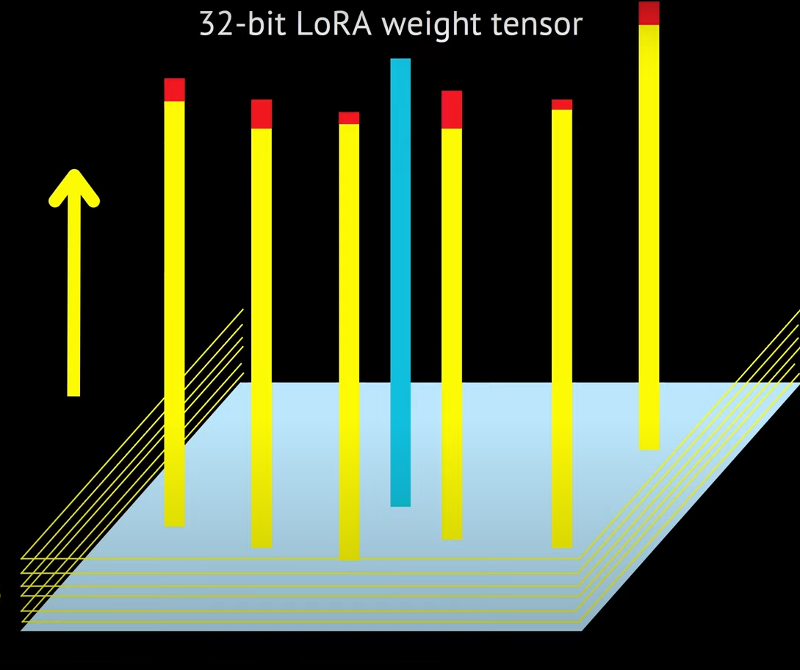
How does QLORA work?

Slide 16
BitsAndBytes and PEFT
The bitsandbytes library is a lightweight, open-source library that focuses on optimizing large language models for efficiency. It provides tools for quantization and memory-efficient training, which are essential when working with models like Phi-2 during fine-tuning tasks such as QLoRA (Quantized Low-Rank Adaptation). We loaded Phi-2 model in 4 bites.
The PEFT library is an open-source library designed to efficiently fine-tune large language models without updating all model parameters. It enables low-rank adaptation (LoRA) and other parameter-efficient techniques, drastically reducing memory and compute requirements. PEFT is widely used in fine-tuning tasks like QLoRA, where only a small fraction of the model’s weights are updated, making training feasible on consumer GPUs.

Slide 17
DialogSum dataset
The DialogSum dataset, developed by Karthick Kaliannan Neelamohan, is a large-scale resource designed for dialogue summarization tasks. It comprises of large number of dialogues, each accompanied by a human-written summary and a topic label. The dataset is divided into training, validation, and test sets, facilitating the development and evaluation of summarization models.
Dataset Structure:
Training Set: 12,500 dialogues
Validation Set: 500 dialogues
Test Set: 1,500 dialogues

Slide 18
Structure of the dataset
Each dialogue is structured with the following fields:
id: Unique identifier for the dialogue
dialogue: The conversation text
summary: A concise summary of the dialogue
topic: A one-liner indicating the main topic of the dialogue

Slide 19
Significance to our Model
Utilizing the DialogSum dataset with 12,500 training examples offers several advantages:
Diverse Real-Life Scenarios: The dialogues encompass a wide range of everyday topics, including schooling, work, medication, shopping, leisure, and travel. This diversity ensures that our model is exposed to various conversational contexts, enhancing its generalization capabilities.
Clear Communication Patterns: The dataset features dialogues with distinct communication patterns and intents, providing a solid foundation for training models to understand and summarize conversations effectively.
Structured Data Format: The consistent structure of each dialogue, summary, and topic label facilitates straightforward preprocessing and integration into our model's training pipeline.
Benchmarking and Evaluation: The availability of validation and test sets allows for rigorous evaluation of our model's performance, enabling us to benchmark against established standards in the field.
By leveraging the DialogSum dataset, our model can learn to generate accurate and contextually relevant summaries, thereby advancing the field of dialogue summarization.

Slide 20
Model Performance Comparison: Original vs. PEFT Model
We evaluated the performance of two models using ROUGE scores, a standard metric for text summarization tasks. Below is a summary of the results and their implications:
ROUGE Scores:
ROUGE-1 (Unigram Overlap):
Original Model: 0.3524
PEFT Model: 0.3497
Change: -0.28% (slightly worse)
ROUGE-2 (Bigram Overlap):
Original Model: 0.1291
PEFT Model: 0.1234
Change: -0.57% (slightly worse)
ROUGE-L (Longest Common Subsequence):
Original Model: 0.2632
PEFT Model: 0.2770
Change: +1.37% (improved)
ROUGE-Lsum (Summarized Longest Common Subsequence):
Original Model: 0.2614
PEFT Model: 0.2769
Change: +1.55% (improved)

Slide 21
Concluding Remarks
Through this project, we explored the process of fine-tuning a pre-trained language model, Phi-2, for dialogue summarization using datasets like DialogSum and DialogSum-test from Hugging Face. Our work demonstrated how fine-tuning can adapt a large language model to handle specific tasks effectively.
We used state-of-the-art methods like QLoRA and integrated tools such as the bitsandbytes library to optimize the process, ensuring computational efficiency while maintaining strong performance. This project allowed us to gain a deeper understanding of advanced NLP techniques, model optimization, and the practical challenges of working with conversational data.

Slide 22
Key Takeaways
Fine-tuning bridges the gap between general-purpose models and task-specific applications.
Parameter-efficient methods like QLoRA make it possible to fine-tune large models on resource-constrained hardware.
Tools like bitsandbytes simplify the quantization process, making training more efficient.
This project has been an insightful step into the world of large language models, providing us with valuable experience in handling datasets, algorithms, and model optimization techniques.

Slide 23
Thank you for your attention! We look forward to your feedback and questions.
Andrej Veljanoski 2/2021
Kristijan Milosheski 8/2021
Petar Cvetanoski 175/2021

